Slide 1
Data Structures using C
MULTI WAY SEARCH TREE
B Trees

Slide 2
Till Date what ever sorting we have studied is internal sorting
Assumed that what ever data is to be searched
is in primary memory
Now we will study about external searching

Slide 3
Access time is more in case of secondary stoarge
Aim during external searching is to reduce the no of access when data is searched from external storage.
A whole block is read instead of a single word.
A data structure was devised suitable for External sorting called M way search tree.

Slide 4
INTRODUCTION (1/3)
Binary Search tree contain one value and two pointers: left and right, which point to nodes left and right sub tree.
Same concept in M-way search trees:
Which has m-1 values per node and M sub trees.
M is called the degree of the tree.
Note in a binary search tree M = 2, so it has one value and 2 sub-trees. In other words, every internal node of an M-way search tree consists of pointers to M sub-trees and contains M – 1 keys, where M > 2.

Slide 5
INTRODUCTION (2/3)
P₀ | K₀ | P₁ | K₁ | P₂ | K₂ | …… | P_{n-1} | K_{n-1} | P_{n}
In the structure, P0, P1, P2,…, Pn are pointers to the node’s sub-trees and K0, K1, K2,…, Kn-1 are the key values of the node. All the key values are stored in ascending order. That is, Ki < Ki+1 for 0 ≤ i ≤ n-2.
In an M-way search tree, it is not compulsory that every node has exactly (M-1) values and have exactly M sub-trees. Rather, the node can have anywhere from 1 to (M-1) values, and the number of sub-trees may vary from 0 (for a leaf node) to 1 + i, where i is the number of key values in the node. M is thus a fixed upper limit that defines how much key values can be stored in the node.

Slide 6
INTRODUCTION (3/3)
 | 18 |  | 45
 | 9 |  | 11
 | 27 |  | 36
 | 54 |  | 63
 | 29 |  | 30
 | 72 |  | 81
In the structure, P0, P1, P2,…, Pn are pointers to the node’s sub-trees and K0, K1, K2,…, Kn-1 are the key values of the node. All the key values are stored in ascending order. That is, Ki < Ki+1 for 0 ≤ i ≤ n-2.
In an M-way search tree, it is not compulsory that every node has exactly (M-1) values and have exactly M sub-trees. Rather, the node can have anywhere from 1 to (M-1) values, and the number of sub-trees may vary from 0 (for a leaf node) to 1 + i, where i is the number of key values in the node. M is thus a fixed upper limit that defines how much key values can be stored in the node.

Slide 7
B Trees
A B-tree is a specialized m- way tree that is widely used for disk access.
Used to index the Data in a Data base of very large size and provide fast Access.
B tree of order m can have maximum m-1 keys and m pointers to its sub-trees. A B-tree may contain a large number of key values and pointers to sub-trees. Storing a large number of keys in a single node keeps the height of the tree relatively small.
A B-tree is designed to store sorted data and allows search, insert, and delete operations to be performed in logarithmic amortized time. A B-tree of order m (the maximum number of children that each node can have) is a tree with all the properties of an m-way search tree and in addition has the following properties:
Every node in the B-tree has at most (maximum) m children.

Slide 8
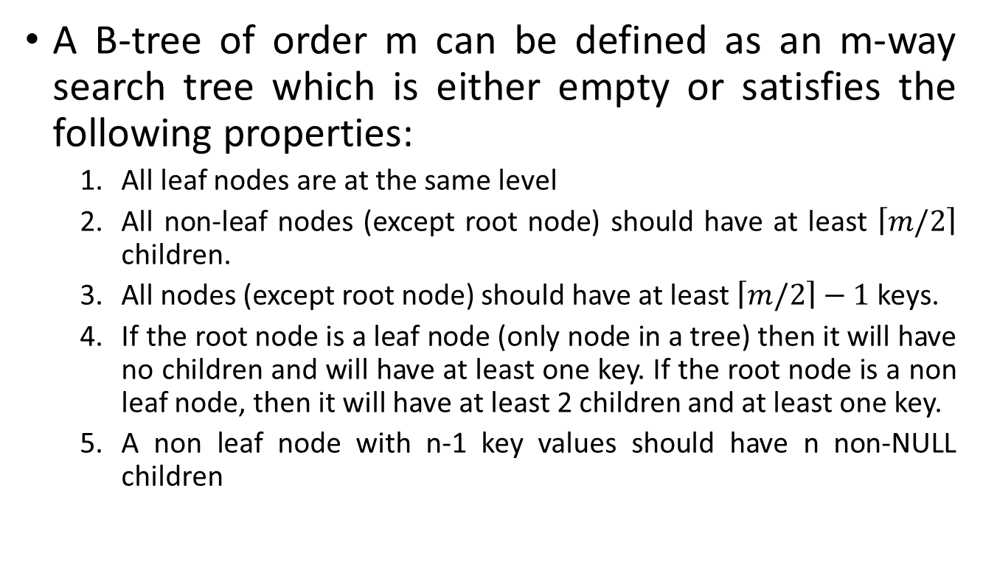
B Trees
A B-tree of order m can be defined as an m-way search tree which is either empty or satisfies the following properties:
All leaf nodes are at the same level
All non-leaf nodes (except root node) should have at least $\left\lceil m/2\right\rceil$ children.
All nodes (except root node) should have at least $\left\lceil m/2\right\rceil −1$ keys.
If the root node is a leaf node (only node in a tree) then it will have no children and will have at least one key. If the root node is a non leaf node, then it will have at least 2 children and at least one key.
A non leaf node with n-1 key values should have n non-NULL children

Slide 9
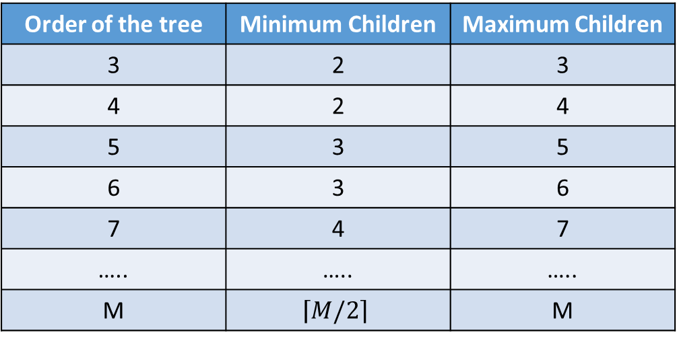
B Trees
The following figure shows the minimum and maximum number of children in any non-root and non-leaf node of B-Trees of different orders.
Order of the tree | Minimum Children | Maximum Children
3 | 2 | 3
4 | 2 | 4
5 | 3 | 5
6 | 3 | 6
7 | 4 | 7
….. | ….. | …..
M | $$\left\lceil M/2\right\rceil$$ | M

Slide 10
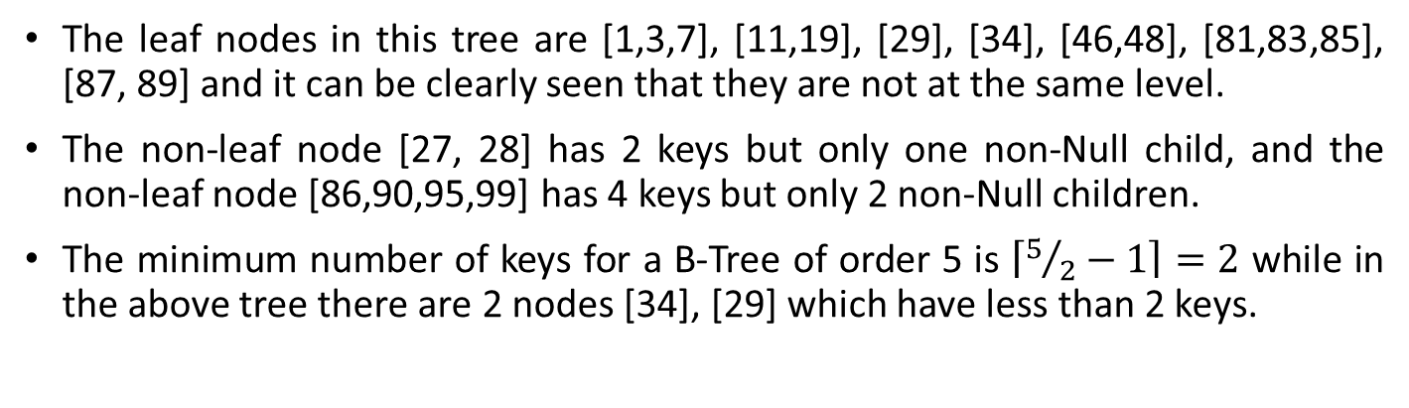
B Trees (Comparison)
30 | 40 | 80
8 | 25
34
46 | 48
86 | 90 | 95 | 99
1 | 3 | 7
11 | 19
27 | 28
81 | 83 | 85
87 | 89
29
The leaf nodes in this tree are [1,3,7], [11,19], [29], [34], [46,48], [81,83,85], [87, 89] and it can be clearly seen that they are not at the same level.
The non-leaf node [27, 28] has 2 keys but only one non-Null child, and the non-leaf node [86,90,95,99] has 4 keys but only 2 non-Null children.
The minimum number of keys for a B-Tree of order 5 is $\left\lceil 5/2−1\right\rceil =2$ while in the above tree there are 2 nodes [34], [29] which have less than 2 keys.

Slide 11
B Trees → INSERTION → Algorithm
In a B tree all insertions are done at the leaf node level. A new value is inserted in the B tree using the algorithm given below.
Search the B tree to find the leaf node where the new key value should be inserted.
If the leaf node is not full, that is it contains less than m-1 key values then insert the new element in the node, keeping the node's elements ordered.
If the leaf node is full, that is the leaf node already contain m-1 key values then
Insert the new value in order into the existing set of keys split the node at its median into two nodes. note that the split nodes are half full. Push the median element up to its parent’s node. If the parent’s node is already full, then split the parent node by following the same steps.

Slide 12
B Trees → INSERTION → Example (1/7)
To Insert (in order 5): 10, 40, 30, 35, 20, 15, 50, 28, 25, 5, 60, 19, 12, 38, 27, 90, 45, 48
Insert 10
Insert 40
Insert 30
30 will be inserted between 10 and 40 since all the keys in a node should be in ascending order.
Insert 35
The maximum number of permissible keys for a node of a B-Tree of order 5 is 4, so now after insertion of 35, this node has become full.
10
10 | 40
10 | 30 | 40
10 | 30 | 35 | 40

Slide 13
B Trees → INSERTION → Example (2/7)
To Insert (in order 5): 10, 40, 30, 35, 20, 15, 50, 28, 25, 5, 60, 19, 12, 38, 27, 90, 45, 48
10 | 30 | 35 | 40
← Previous Status
Insert 20
This node [10,30,35,40] will become overfull [10,20,30,35,40], so splitting is done at the median key 30. A new node is allocated and keys to the right of median key i.e. 35 and 40 are moved to the new node and the keys to the left of the median key i.e. 10 and 20 remain in the same node. Generally after splitting, the median key goes to the parent node, but here the node that is being split is the root node, so a new node is allocated which contains the median key and now this node becomes the root of the tree.
30
Since the root node has been split, the height of the tree has increased by one
10 | 20
35 | 40
Notes:
Insert 20
This node [10,30,35,40] will become overfull [10,20,30,35,40], so splitting is done at the median key 30. A new node is allocated and keys to the right of median key i.e. 35 and 40 are moved to the new node and the keys to the left of the median key i.e. 10 and 20 remain in the same node. Generally after splitting, the median key goes to the parent node, but here the node that is being split is the root node, so a new node is allocated which contains the median key and now this node becomes the root of the tree.

Slide 14
B Trees → INSERTION → Example (3/7)
To Insert (in order 5): 10, 40, 30, 35, 20, 15, 50, 28, 25, 5, 60, 19, 12, 38, 27, 90, 45, 48
30
← Previous Status
10 | 20
35 | 40
Insert 15, 50, 28
15 and 28 are less than 30 so they are inserted in the left node at appropriate place and 50 is greater than 30 so it is inserted in the right node.
30
10 | 15 | 20 | 28
35 | 40 | 50

Slide 15
B Trees → INSERTION → Example (4/7)
To Insert (in order 5): 10, 40, 30, 35, 20, 15, 50, 28, 25, 5, 60, 19, 12, 38, 27, 90, 45, 48
30
← Previous Status
10 | 15 | 20 | 28
35 | 40 | 50
Insert 25
The node [10,15,20,28] will become overfull [10,15,20,25,28] so splitting is done and the median key 20 goes to the parent node.
20 | 30
10 | 15
25 | 28
35 | 40 | 50
20 | 30
Insert 5, 60, 19
5 | 10 | 15 | 19
25 | 28
35 | 40 | 50 | 60

Slide 16
B Trees → INSERTION → Example (5/7)
To Insert (in order 5): 10, 40, 30, 35, 20, 15, 50, 28, 25, 5, 60, 19, 12, 38, 27, 90, 45, 48
20 | 30
← Previous Status
5 | 10 | 15 | 19
25 | 28
35 | 40 | 50 | 60
Insert 12
The node [5,10,15,19] will become overfull [5,10,12,15,19] so splitting is done and the median key 12 goes to the parent node.
12 | 20 | 30
5 | 10
15 | 19
25 | 28
35 | 40 | 50 | 60
Insert 38
The node [35,40,50,60] will become overfull [35,38,40,50,60] so splitting is done and the median key 40 goes to the parent node.
12 | 20 | 30 | 40
5 | 10
15 | 19
25 | 28
35 | 38
50 | 60

Slide 17
B Trees → INSERTION → Example (6/7)
To Insert (in order 5): 10, 40, 30, 35, 20, 15, 50, 28, 25, 5, 60, 19, 12, 38, 27, 90, 45, 48
12 | 20 | 30 | 40
← Previous Status
5 | 10
15 | 19
25 | 28
35 | 38
50 | 60
Insert 27, 90, 45
12 | 20 | 30 | 40
5 | 10
15 | 19
25 | 27 | 28
35 | 38
45 | 50 | 60 | 90

Slide 18
B Trees → INSERTION → Example (7/7)
To Insert (in order 5): 10, 40, 30, 35, 20, 15, 50, 28, 25, 5, 60, 19, 12, 38, 27, 90, 45, 48
12 | 20 | 30 | 40
← Previous Status
5 | 10
15 | 19
25 | 27 | 28
35 | 38
45 | 50 | 60 | 90
Insert 48
The node [45,50,60,90] will become overfull [45,48,50,60,90], so splitting is done and the median key 50 goes to the parent node. After insertion of 50 the parent node also becomes overfull [12,20,30,40,50] so again splitting is done and this time root node is split so a new root is formed and the tree becomes taller.
30
12 | 20
40 | 50
5 | 10
15 | 19
25 | 27 | 28
35 | 38
45 | 48
60 | 90

Slide 19
B Trees → INSERTION → Example 2
To Insert (in order 5): 8, 9, 39
Given Tree →
18 | 45 | 72
7 | 11
21 | 27 | 36 | 42
54 | 63
81 | 89 | 90
Insert 8
18 | 45 | 72
7 | 8 | 11
21 | 27 | 36 | 42
54 | 63
81 | 89 | 90
Insert 9
18 | 45 | 72
7 | 8 | 9 | 11
21 | 27 | 36 | 42
54 | 63
81 | 89 | 90
Insert 39
18 | 36 | 45 | 72
7 | 8 | 9 | 11
21 | 27
39 | 42
54 | 63
81 | 89 | 90

Slide 20
B Trees → DELETION → Algorithm (1/2)
Like insertion, deletion is also done from the leaf nodes. There are two cases of deletion. First, a leaf node has to be deleted. Second, an internal node has to be deleted.
Let us first see the steps involved in deleting a leaf node.
Locate the leaf node which has to be deleted
If the leaf node contains more than minimum number of key values (more than m/2 elements), then delete the value.
Else, if the leaf node does not contain even m/2 elements then, fill the node by taking an element either from the left or from the right sibling
If the left sibling has more than the minimum number of key values (elements), push its largest key into its parent’s node and pull down the intervening element from the parent node to the leaf node where the key is deleted. Else if the right sibling has more than the minimum number of key values (elements), push its smallest key into its parent node and pull down the intervening element from the parent node to the leaf node where the key is deleted.

Slide 21
B Trees → DELETION → Algorithm (2/2)
Else, if both left and right siblings contain only minimum number of elements, then create a new leaf node by combining the two leaf nodes and the intervening element of the parent node (ensuring that the number of elements do not exceed the maximum number of elements a node can have, that is, m). If pulling the intervening element from the parent node leaves it with less than minimum number of keys in the node, then propagate the process upwards thereby reducing the height of the B tree.
To delete an internal node, promote the successor or predecessor of the key to be deleted to occupy the position of the deleted key. This predecessor or successor will always be in the leaf node. So further the processing will be done as if a value from the leaf node has been deleted

Slide 22
B Trees → DELETION
Deletion in a B tree can be classified in two cases:
Deletion from leaf node
Deletion from non-leaf node

Slide 23
B Trees → DELETION → Example (1/10)
Task: Delete 52 from the given tree
Given Tree →
30
12 | 20
40 | 55
3 | 7 | 9 | 11
15 | 19
25 | 28
35 | 38
45 | 47 | 52
65 | 78
After Deleting 52
30
12 | 20
40 | 55
3 | 7 | 9 | 11
15 | 19
25 | 28
35 | 38
45 | 47
65 | 78

Slide 24
B Trees → DELETION → Example (2/10)
Task: Delete 15 from the given tree | Case: Node has MIN Keys
Given Tree →
30
12 | 20
40 | 55
3 | 7 | 9 | 11
15 | 19
22 | 25 | 28
35 | 38
45 | 47
65 | 78 | 80
Here key 15 is to be deleted from node [15,19], since this node has only MIN keys, we will try to borrow from its left sibling [3,7,9,11] which has more than MIN keys. The parent of these nodes is node [12, 20] and the separator key is 12. So the last key of left sibling(11) is moved to the place of separator key and the separator key is moved to the underflow node. The resulting tree after deletion of 15 will be:
After deleting 15 →
30
11 | 20
40 | 55
3 | 7 | 9
12 | 19
22 | 25 | 28
35 | 38
45 | 47
65 | 78 | 80

Slide 25
B Trees → DELETION → Example (3/10)
Task: Delete 19 from the given tree
Given Tree →
30
11 | 20
40 | 55
3 | 7 | 9
12 | 19
22 | 25 | 28
35 | 38
45 | 47
65 | 78 | 80
We will borrow from the left sibling so key 9 will be moved up to the parent node and 11 will be shifted to the underflow node. In the underflow node the key 12 will be shifted to the right to make place for 11.
After deleting 19 →
30
9 | 20
40 | 55
3 | 7
11 | 12
22 | 25 | 28
35 | 38
45 | 47
65 | 78 | 80

Slide 26
B Trees → DELETION → Example (4/10)
Task: Delete 45 from the given tree
Given Tree →
30
9 | 20
40 | 55
3 | 7
11 | 12
22 | 25 | 28
35 | 38
45 | 47
65 | 78 | 80
The left sibling of [45, 47] is [35, 38] which has only MIN keys so we can’t borrow from it, hence we will try to borrow from the right sibling [65, 78, 80]. The first key of the right sibling (65) is moved to the parent node and the separator key from the parent node (55) is moved to the underflow node. In the underflow node, 47 is shifted left to make room for 55. In the right sibling, 78 and 80 are moved to fill the gap created by removal of 65.
30
After deleting 45→
9 | 20
40 | 65
3 | 7
11 | 12
22 | 25 | 28
35 | 38
47 | 55
78 | 80
If both left and right siblings of underflow node have MIN keys, then we can’t borrow from any of the siblings. In this case, the underflow node is combined with its left (or right) sibling.

Slide 27
B Trees → DELETION → Example (5/10)
Task: Delete 28 from the given tree
Given Tree →
55
15 | 24 | 36 | 45
64 | 73 | 89
5 | 10
18 | 22
28 | 31
39 | 43
47 | 53
58 | 62
67 | 71
76 | 86
92 | 95
We can see that the node [28, 31] has only MIN keys so we’ll try to borrow from left sibling [18, 22], but it also has MIN keys so we’ll look at the right sibling [39, 43] which also has only MIN keys. So after deletion of 28 we’ll combine the underflow node with its left sibling. For combining these two nodes the separator key (24) from the parent node will move down in the combined node.
After deleting 28→
55
15 | 36 | 45
64 | 73 | 89
5 | 10
18 | 22 | 24 | 31
39 | 43
47 | 53
58 | 62
67 | 71
76 | 86
92 | 95

Slide 28
B Trees → DELETION → Example (6/10)
Task: Delete 62 from the given tree
Given Tree →
55
15 | 36 | 45
64 | 73 | 89
5 | 10
18 | 22 | 24 | 31
39 | 43
47 | 53
58 | 62
67 | 71
76 | 86
92 | 95
Here the key is to be deleted from [58, 62] which is leftmost child of its parent, and hence it has no left sibling. So here we’ll look at the right sibling for borrowing a key, but the right sibling has only MIN keys, so we’ll delete 62 and combine the underflow node with the right sibling.
After deleting 62 →
55
15 | 36 | 45
73 | 89
5 | 10
18 | 22 | 24 | 31
39 | 43
47 | 53
58 | 64 | 67 | 71
76 | 86
92 | 95

Slide 29
B Trees → DELETION → Example (7/10)
Task: Delete 31 from the given tree
Given Tree →
45
15 | 36
55 | 73
5 | 10
18 | 31
39 | 43
47 | 53
58 | 64 | 67 | 71
76 | 86 | 89 | 95
The underflow node [18] is combining with its left sibling
45
36
55 | 73
5 | 10 | 15 | 18
39 | 43
47 | 53
58 | 64 | 67 | 71
76 | 86 | 89 | 95
Contd. To next slide

Slide 30
B Trees → DELETION → Example (8/10)
Task: Delete 31 from the given tree (contd.)
Previous State →
45
36
55 | 73
5 | 10 | 15 | 18
39 | 43
47 | 53
58 | 64 | 67 | 71
76 | 86 | 89 | 95
Now the parent node [36] has become underflow so we will try to borrow a key from its right sibling (since it is leftmost node and has no left sibling), but the right sibling has MIN keys so we will combine the underflow node [36] with its right sibling [55, 73]. The separator key (45) comes down in the combined node, and since it was the only key in the root node, now the root node becomes empty and the combined node becomes the new root of the tree and height of the tree decreases by one.
After deleting 31 →
36 | 45 | 55 | 73
5 | 10 | 15 | 18
39 | 43
47 | 53
58 | 64 | 67 | 71
76 | 86 | 89 | 95

Slide 31
B Trees → DELETION
Deletion from a Non-leaf Node:
In this case, the successor key is copied at the place of the key to be deleted and then the successor is deleted. Successor key is the smallest key in the right subtree and will always be in the leaf node. So this case reduces to case A of deletion from a leaf node.

Slide 32
B Trees → DELETION → Example (9/10)
Task: Delete 12 from the given tree | Case: Deletion from Non-Leaf Node
Given Tree →
30
12 | 20
40 | 50 | 60
5 | 10
15 | 19
25 | 27 | 28
35 | 38
45 | 48
53 | 57
69 | 78
The successor key of 12 is 15, so we’ll copy 15 at the place of 12 and now our task reduces to deletion of 15 from the leaf node. This deletion is performed by borrowing a key from the right sibling.
30
15 | 20
40 | 50 | 60
5 | 10
15 | 19
25 | 27 | 28
35 | 38
45 | 48
53 | 57
69 | 78
30
After deleting 12 →
15 | 25
40 | 50 | 60
5 | 10
19 | 20
27 | 28
35 | 38
45 | 48
53 | 57
69 | 78

Slide 33
B Trees → DELETION → Example (10/10)
Task: Delete 30 from the given tree
Given Tree →
30
15 | 25
40 | 50 | 60
5 | 10
19 | 20
27 | 28
35 | 38
45 | 48
53 | 57
69 | 78
The successor key of 30 is 35, so it is copied at the place of 30 and now 35 will be deleted from the leaf node.
35
15 | 25
40 | 50 | 60
5 | 10
19 | 20
27 | 28
35 | 38
45 | 48
53 | 57
69 | 78
After deleting 30 →
35
15 | 25
50 | 60
5 | 10
19 | 20
27 | 28
38 | 40 | 45 | 48
53 | 57
69 | 78

Slide 34
B+ Trees
A B+ tree is a variant of a B tree which stores sorted data in a way that allows for efficient insertion, retrieval and removal of records, each of which is identified by a key.
While a B tree can store both keys and records in its interior nodes, a B+ tree, in contrast, stores all records at the leaf level of the tree; only keys are stored in interior nodes.
The leaf nodes of the B+ tree are often linked to one another in a linked list. This has an added advantage of making the queries simpler and more efficient.
Typically B+-trees are used to store large amounts of data that cannot be stored in the main memory. With B+ trees, the secondary storage (magnetic disk) is used to store the leaf nodes of the tree and the internal nodes of the tree are stored in the main memory.
B+-tree stores data only in the leaf nodes.
All other nodes (internal nodes) are called index nodes or i-nodes and store index values which allow us to traverse the tree from the root down to the leaf node that stores the desired data item.

Slide 35
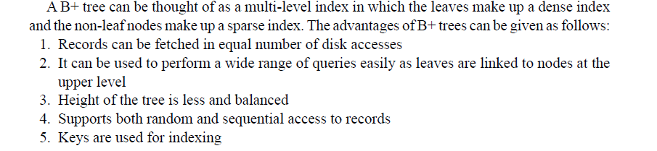
Advantage of B+ tree

Slide 36
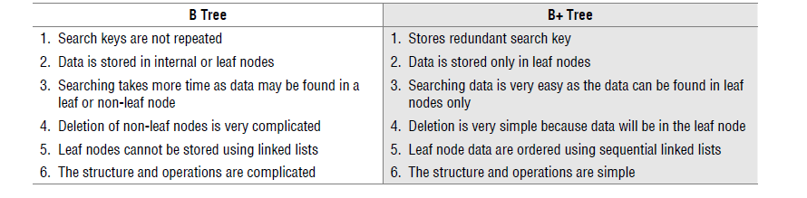
Comparison B and B+ Tree

Slide 37
B+ tree which is a variation of B tree, is well suited for sequential access. The two main differences in B tree and B+ tree are
in B tree, all the nodes contain keys, their corresponding data items (records or pointers to records), and child pointers
but in B+ tree the structures of leaf nodes and internal nodes are different. The internal nodes store only keys and child pointers while the leaf nodes store keys and their corresponding data items.
So the data items are present only in the leaf nodes. The keys in the leaf nodes may also be present in the internal nodes.
2. In B+ tree, each leaf node has a pointer that points to the next leaf node i.e. all leaf nodes form a linked list.

Slide 38
Insertion
First a search is performed (if key is not present in the leaf node)
If the leaf node has less then max no of keys
then it is simply inserted in the leaf node.
( in the order and index set is not changed)
If the leaf node has max keys then split leaf node.

Slide 39
Insertion
The splitting of a leaf node is slightly different from splitting of a node in a B tree.
A new leaf node is allocated and inserted in the sequence set(linked list of leaf nodes) after the old node.
All the keys smaller than the median key remain in the old leaf node.
All the keys greater than equal to the median key are moved to the new node, the corresponding data items are also moved.
The median key becomes the first key of the new node and this key(without data item) is copied (not moved) to the parent node which is an internal node.
This median key is present both in the leaf node and in the internal node which is the parent of the leaf node.

Slide 40
Splitting
Splitting of a leaf node
keys < median remain in old leaf node
keys >= median go to new leaf node
Median key is copied to the parent node.
Splitting of an internal node:-
keys<median remains in the old leaf node.
keys>median go to the new leaf node.
Median Key is moved to the parent node.

Slide 41
Deletion
If the key is present in a leaf which has minimum number of nodes then we have two cases
(A) If any one of the siblings has more than minimum nodes then a key is borrowed from it and the separator key in the parent node is updated accordingly.
If we borrow from the left sibling then, rightmost key(with data item) of left sibling is moved to the underflow node. Now this new leftmost key in the underflow node becomes the new separator key.
If we borrow from the right sibling then the leftmost key(with data item) of the right sibling is moved to the underflow node. Now the key which is leftmost in the right sibling becomes the new separator key

Slide 42
If both siblings have minimum nodes then we need to merge the underflow leaf node with its sibling.
This is done by moving the keys(with data) of the underflow leaf node to the sibling node and deleting the underflow leaf node.
The separator key of the underflow node and its sibling is deleted from the parent node, and the corresponding child pointer in parent node is also removed.

